Slide 1

Travel App
MCON 152 Fall 2024
Faigy Feinberg
Shoshana Hammer
Adina Lew
Sarah Nechama Starkman

Slide 2

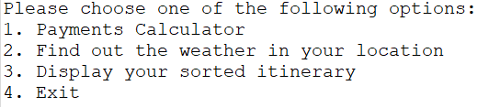
Project Vision
APP TO STREAMLINE GROUP VACATIONS
App Features:
Group Costs calculator
Weather Report
Itinerary

Slide 3
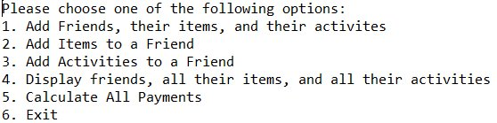
Payments Calculator Split costs of group travel efficiently between all travelers.
HOW IT WORKS:
Add a traveler to the group. Options available to add paid items or paid activities when adding the traveler, or separately to an existing traveler.
Display all travelers and correlated data
Calculate the payments for all travelers and paid items and activities
Exit to Main Menu at any time

Slide 4
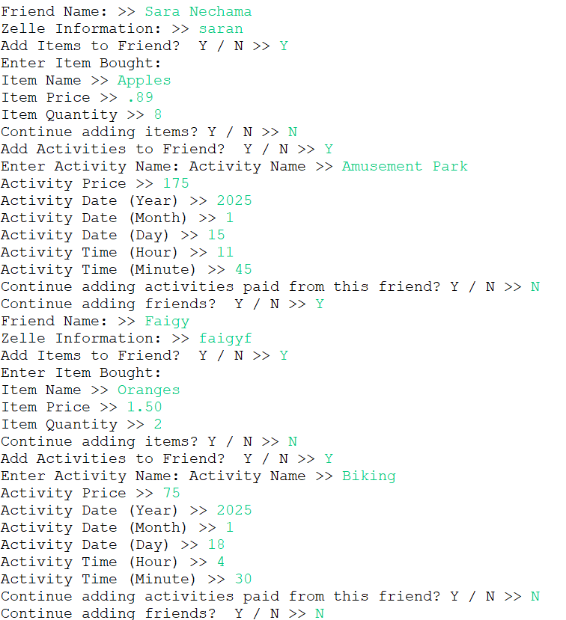











IN ACTION: ADD FRIEND
Add traveler's name, zelle information, items (if applicable), activities (if applicable)
Activities added here will be included in the itinerary.
Customizable: choices to continue adding items, activities, or travelers

Slide 5
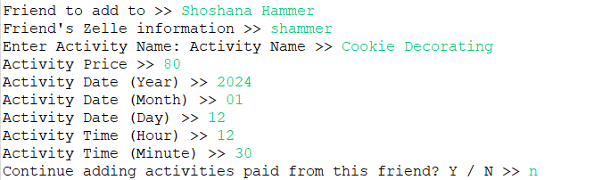
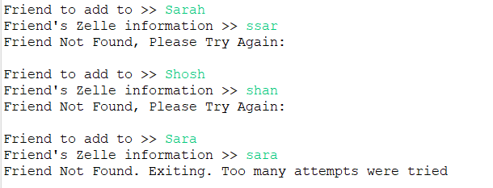
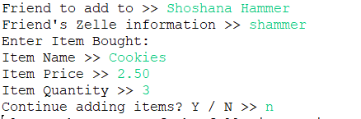
IN ACTION: ADD ITEMS / ADD ACTIVITES
Add items or activities to an existing friend
Activities will be included in the itinerary
There will be three attempts to find the friend who paid for the item or activity. If the friend is not found, the program will exit to the Payment Calculator Menu

Slide 6
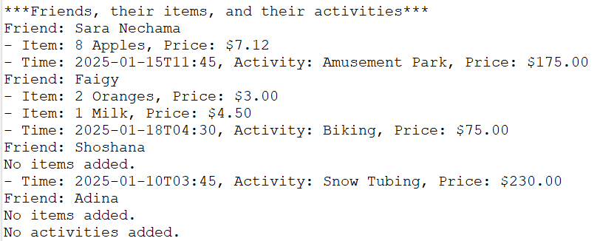
IN ACTION: DISPLAY
Displays travelers with their paid items and activities

Slide 7
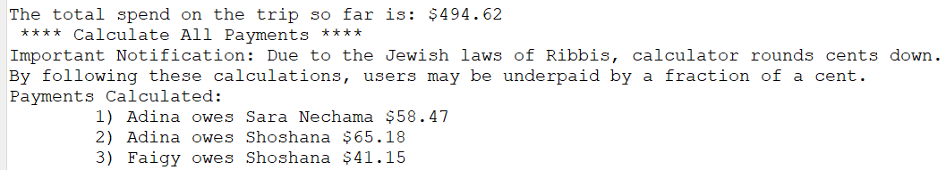
IN ACTION: CALCULATOR
Calculator will calculate most efficient payments using all travelers and their payments.

Slide 8
Behind the Scenes: Calculator
Friends | Shoshana: $30 | Faigy: $40 | Adina: $10 | SN: $4
Each Person Should Pay: 30 + 40 + 4 + 10 = 84 / 4 people = $21 per person
Underpaid | Overpaid
Adina - $4, owes $21-4=$17 | Faigy- $40, deserves $40–21=$19
SN- $10, owes $21-10=$11 | Shoshana- $34, deserves $30–21 =$9
Paid Least
Paid Most
Paid Most
Paid Least

Slide 9
Behind the Scenes: Calculator cont.
Payment for $17 from Adina-Faigy is added to an ArrayList.
Payments ArrayList:
Underpaid | Overpaid
Adina - $4, owes $21-4=$17-17=$0 | Faigy- $40, deserves $40–21=$19-17=$2
SN- $10, owes $21-10=$11 | Shoshana- $34, deserves $30–21 =$9
Adina
Faigy
$17
Payment for $2 from Shoshana is added to an ArrayList
Underpaid | Overpaid
Adina - $4, owes $21-4=$17-17=$0 | Faigy- $40, deserves $40–21=$19-17=$2-2=$0
SN- $10, owes $21-10=$11-2=$9 | Shoshana- $34, deserves $30–21 =$9
Adina
Faigy
$17
SN
Faigy
$2
Payment for $9 from SN-Shoshana is added to an ArrayList. Everyone is happy!
Underpaid | Overpaid
Adina - $4, owes $21-4=$17-17=$0 | Faigy- $40, deserves $40–21=$19-17=$2-2=$0
SN- $10, owes $21-10=$11-2=$9-9=$0 | Shoshana- $34, deserves $30–21 =$9-9=$0
Adina
Faigy
$17
SN
Faigy
$2
SN
Shoshana
$9

Slide 10

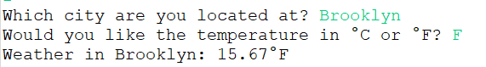
Weather
Plan your trip with real-time weather updates for your travel destination.
HOW IT WORKS:
Specify location
Choose metric
View temperature in the area

Slide 11
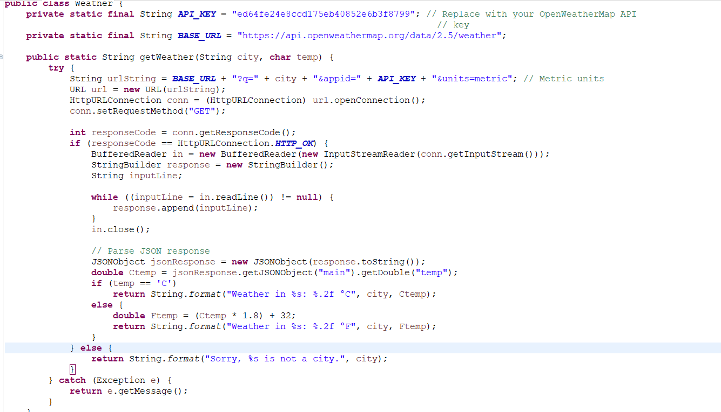
Behind the Scenes: Weather
We used an API connection to assist with real time temperature statistics.

Slide 12
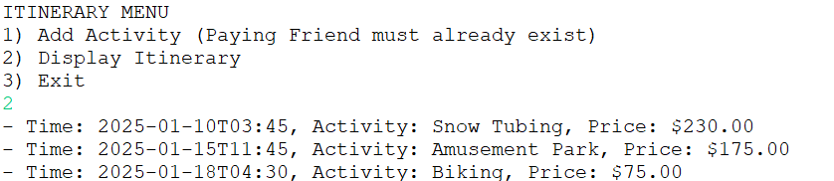
Itinerary
HOW IT WORKS:
Add activity to an existing traveler. This will be included in the calculator for the paying traveler.
Display Itinerary in order of activity timing. This includes activities added in both the Calculator section of the app, and this section of the app.
Exit to Main Menu

Slide 13
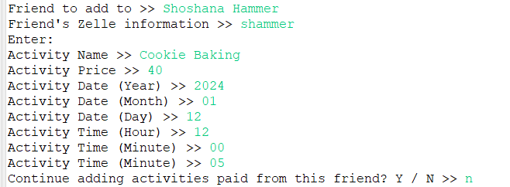
In Action: Add Activity

Slide 14
In Action: Display Itinerary

